Slide 1
Metrics/Bias Variance Trade-Off
Michael Gilbert

Slide 2
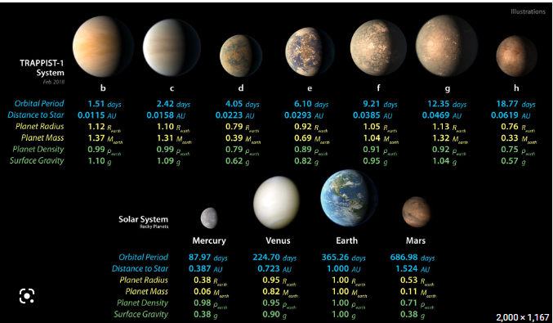
Example problem
Imagine we have a dataset of 1M planet like object in the galaxy.
We are trying to predict whether each planet could harbor life or not.
Out of 1M examples how many might we expect to harbor life?

Slide 3
Model
Considering the previous slide consider a model with no features which just returns the label 0 (no life) each time
Y = 0
What is this model’s accuracy with a million samples?
Accuracy is a commonly discussed metric but obviously has some shortcomings.
This would be a “zero – R” algorithm
“One – R” – pick one attribute and make a classification based on it.

Slide 4
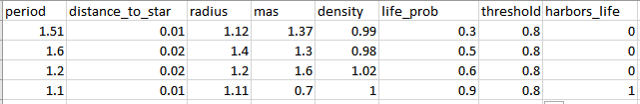




Threshold
We might set some threshold here to turn our probabilistic prediction into a classification.

Slide 5
Prediction Outcome vs Actual Values
The confusion matrix compares our Prediction Outcome to the Actual Values.
 |  | Predicted
 |  | Positive | Negative
Actual | Positive | True Positive (TP) – Predicted life and life actually exists | False Negative (FN) – Predicted no life and life actually exists
 | Negative | False Positive (FP) – Predicted life and life actually does not exist | True Negative (TN) – Predicted no life and life does not actually exist

Slide 6
Precision and Recall
Precision = # of TP / # of All Positive Predictions
When the model said yes was it right?
Did we over detect life?
Recall = # of TP / # of All Actual Positives
Out of all the planets how many did we correctly identify?
Did we miss a planet that had life? (identified it as no life)
 |  | Predicted
 |  | Positive | Negative
Actual | Positive | TP | FN
 | Negative | FP | TN

Slide 7
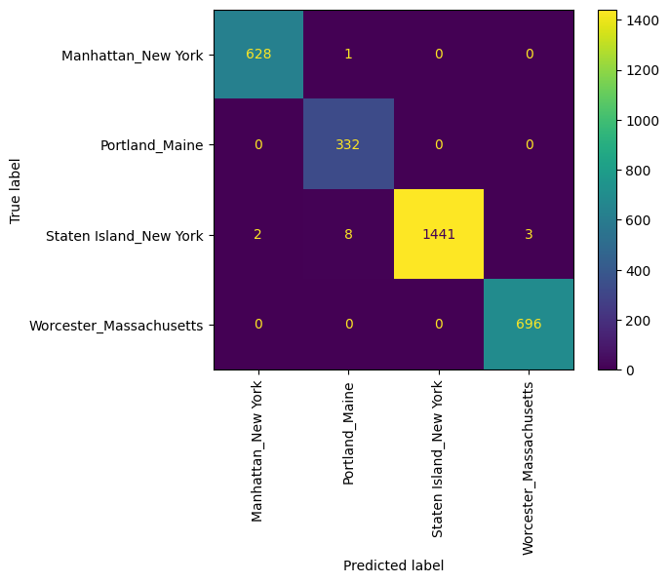

Confusion matrix with several labels
If we have several labels we end up with more cells in our confusion matrix:

Slide 8
Questions
When might you want better precision?
When might you want better recall?
If we lower our threshold from 80% to 70% will our precision go up or down?
How can we increase our recall?

Slide 9

Other metrics
balanced_accuracy_score – accounts for imbalanced label distribution.
F1 Score = (2 * precision * recall) / (precision + recall)
Measures overall performance of classification model
ROC – curve showing results across all threshold values.
True Positives (Recall) vs. False Positives Rate (a.k.a fall-out, 1-True Negative Rate (TNR) or 1-specificity)
AOC is the area under this curve.
AOC provides an aggregate measure of performance across all threshold values.

Slide 10
Example
Confusion Matrix [[18 21] [12 99]]
Logistic Regression Accuracy: (18+99)/(18+21+12+99) = 0.78
Precision: (18)/(18+12) = 0.60
Recall: (18)/(18+21) = 0.46153846153846156
 |  | Predicted
 |  | Positive | Negative
Actual/True | Positive | TP (18) | FN (21)
 | Negative | FP (12) | TN (99)

Slide 11
Considerations
Check Accuracy, Recall and Precision in your test set. If they vary considerably from the training set your model is probably overfit.
If they are similar don’t assume your model is great.
Consider how balanced or imbalanced the classification labels are.
It is generally easier to make classifications if the number of labels is lower.
Changing your threshold changes precision and recall but not AOC
Consider the real work, practical consequences of a True positive, True negative, False positive and false negative.
Confusion matrix results can help highlight weaknesses in your model.
This can be used to improve your model or data collection strategy.
At least help build rules or filter around model weaknesses.
Consider validation and decision boundary visualizations.

Slide 12
Bias Variance Trade-Off
The amount of error in a model can be partitioned into three values
Bias
Variance
Irreducible Error
Want a model that reduces both bias and variance, but usually we find that decreasing one, increases the other. This is called the bias-variance trade-off

Slide 13
Bias Variance Trade-Off
High bias is noticeable when the training and testing error are high, albeit closed together
High variance is noticeable when training error is low and testing error is high…there is a gap between them

Slide 14
Bias Variance Trade-Off
Fix for a high bias model is to choose a different model. Typically, since the higher bias means a simpler model, with fewer degrees of freedom, adding more training data will not help as much
Fix for a high variance model is to either pick a different, simpler model or find more training data.

